Slide 1
FUNCTIONS AND MODULES

Slide 2
Functions:
A function is a block of code which only runs when it is called.
You can pass data, known as parameters, into a function.
Once a function is written, it can be used over and over again.
Types of functions:
Built-in library function
User-defined function
Built-in library function:
It is standard functions in python that are available to use.
Example: print(),input(),int(),float(),str() etc.
User-defined function:
We can create our own functions based on our requirements.
Use:
Helpful to breakdown a larger program into a number of smaller functions.

Slide 3
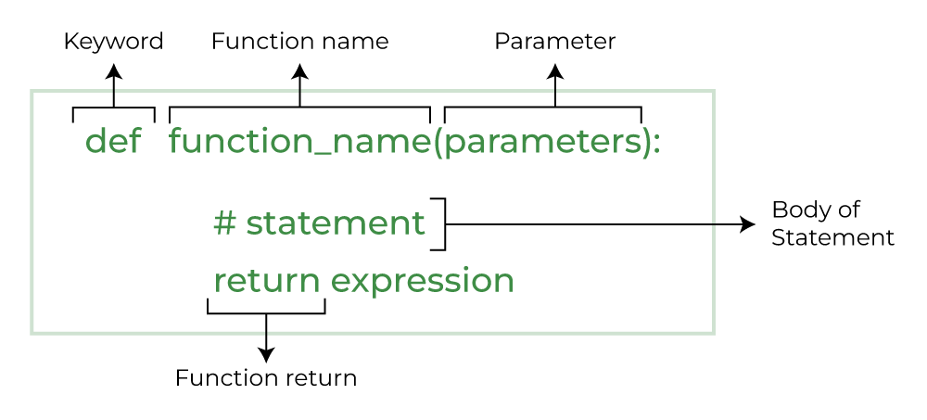
Syntax:

Slide 4
Creating function:
Define a function in python, using the keyword “def”.
Can add parameter within parentheses of the function.
End with colon(:).
Function body must be indented from the function.
Example:
def fun():
print("Welcome python")
Calling function:
def fun():
print("Welcome python")
fun()
Output:
Welcome python

Slide 5
Program for return:
def add(num1, num2):
num3 = num1 + num2
return num3
print("Addition is : ",add(10,20))
Output:
Addition is : 30
Program:
def conv(x):
if(x==1):
return 'one'
if(x==2):
return 'two'
if(x==3):
return 'three'
if(x==4):
return 'four'
n=int(input('Enter a number between 1 and 4:'))
print(n,'in words : ',conv(n))
Output:
Enter a number between 1 and 4:2
2 in words: two

Slide 6
Functional arguments:
Default argumnts
Keyword arguments
Positional arguments
Arbitrary arguments(Variable-length arguments)
Default arguments:
A default argument is a parameter that assumes a default value if a value is not provided in the function call for that argument.
Program:
def myFun(x, y=50):
print("x: ", x)
print("y: ", y)
myFun(10)
Output:
x: 10
y: 50

Slide 7
Keyword arguments:
Value provided in function call with arguments name, so that the caller does not need to remember the order of parameters.
Program:
def student(firstname, lastname):
print(firstname, lastname)
student(firstname='Geeks', lastname='Practice')
student(lastname='Practice', firstname='Geeks')
student(lastname='Geeks', firstname='Practice’)
Output:
Geeks Practice
Geeks Practice
Practice Geeks

Slide 8
Positional arguments:
Value provided in function call in order. If the order change, the values placed in wrong position.
Program:
def nameAge(name, age):
print("Hi, I am", name)
print("My age is ", age)
print("Case-1:")
nameAge("Suraj", 27)
print("\nCase-2:")
nameAge(27, "Suraj")
Output:
Case-1:
Hi, I am Suraj
My age is 27
Case-2:
Hi, I am 27
My age is Suraj

Slide 9
Arbitrary arguments(Variable-length arguments):
can pass a variable number of arguments to a function using special symbols.
There are two special symbols:
Non-Keyword Arguments (*args in Python )
Keyword Arguments (**kvargs in Python )
Program:(Non-Keyword Arguments)
def myFun(*a):
for b in a:
print(b)
myFun('Hello', 'Welcome', 'to', 'GeeksforGeeks’)
Program:(Keyword Arguments)
def myFun(**kwargs):
for key, value in kwargs.items():
print("%s == %s" % (key, value))
myFun(first='Geeks', mid='for', last='Geeks')
Output:
Hello
Welcome
to
GeeksforGeeks
Output:
first == Geeks
mid == for
last == Geeks

Slide 10
Variables:
Variable is containers that store values.
Rules for variables:
A Python variable name must start with a letter or the underscore character.
A Python variable name cannot start with a number.
A Python variable name can only contain alpha-numeric characters and underscores (A-z, 0-9, and _ ).
Variable in Python names are case-sensitive (name, Name, and NAME are three different variables).
The reserved words(keywords) in Python cannot be used to name the variable in Python.
Program:
a = 'apple'
b = 'orange'
c = 'banana'
print(a,b,c)
Output:
apple orange banana

Slide 11
Local variable:
It is defined and declared inside the function.
Program:
def fun():
s = "Welcome"
print(s)
fun()
Global variable:
It is defined and declared outside the function.
Program:
# s = "I Love Python"
def fun():
print(s)
s = "I Love Python"
fun()
Output:
Welcome
Output:
I Love Python

Slide 12
Global keyword:
It is used to create global variables from non-global variable.
It is used inside the function only when we want to change a variable.
Rules of global keyword:
If a variable is assigned a value anywhere within the function’s body, it’s assumed to be local unless explicitly declared as global.
We use a global in Python to use a global variable inside a function.
There is no need to use a global keyword in Python outside a function.
Program:
x = 15
def change():
global x
x = x + 5
print("Inside function:", x)
change()
print("Outside function:", x)
Output:
Inside function : 20
Outside function : 20

Slide 13
Program for global keyword:
x = 0
def compute():
global x
x+=5
print("The value is : ", x)
def display():
global x
x-=3
print("Display : ", x)
#x = 0
compute()
display()
compute()
Output:
The value is : 5
Display : 2
The value is : 7

Slide 14
Lambda functions:
Normal functions are defined using the ‘def’ keyword, anonymous functions are defined using the ‘lambda’ keyword.
A lambda function is a small anonymous function.
Lambda Functions are anonymous functions means that the function is without a name.
A lambda function can take any number of arguments, but can only have one expression.
Syntax:
lambda arguments : expression
Program 1:
double = lambda x: x * 2
print(double(5))
Program 2:
x=lambda a,b:a*b
print(x(5,6))
Output 1:
10
Output 2:
30

Slide 15
Built-in functions:
It is pre-defined functions provided by the Python language that can be used to perform common tasks.
Some built-in functions are,
filter()
map()
reduce()
filter():
It filter the given sequence with the help of a function that tests each element in the sequence to be true or not, and returns the true value.
Syntax:
filter(function, sequence)

Slide 16
Program: lambda
my_list = [1, 5, 4, 6, 8, 11, 3, 12]
new_list = list(filter(lambda x:(x%2 == 0),my_list))
print(new_list)
Output:
[4, 6, 8, 12]
Program: def
def evenval(x):
return x%2==0
even=filter(evenval,range(1,11))
print(list(even))
Output:
[2, 4, 6, 8, 10]

Slide 17
map():
Returns a map object(which is iterator) of the results after applying the given function to each item of a given iterable.
Syntax:
map(fun,seq)
fun: it is a function to which map passes each element of given sequence.
seq: it is iterable which is to be mapped
Program:(def)
def add(n):
return n + n
number = (1,2,3,4)
result = map(add, number)
print(set(result))
Output:
{8, 2, 4, 6}
Program:(lambda)
number = [1,2,3,4]
result = map(lambda x : x + x, number)
print(tuple(result))
Output:
(2, 4, 6, 8)

Slide 18
reduce():
It does not return a new list based on the function . Instead, it returns a single value.
Syntax:
reduce(fun,seq)
Program:
from functools import reduce
list = [2, 4, 7, 3]
print(reduce(lambda x, y: x + y, list))
Program:
import functools
def add(x,y):
return x+y
r=functools.reduce(add,range(1,11))
print(r)
Output:
16
Output:
55

Slide 19
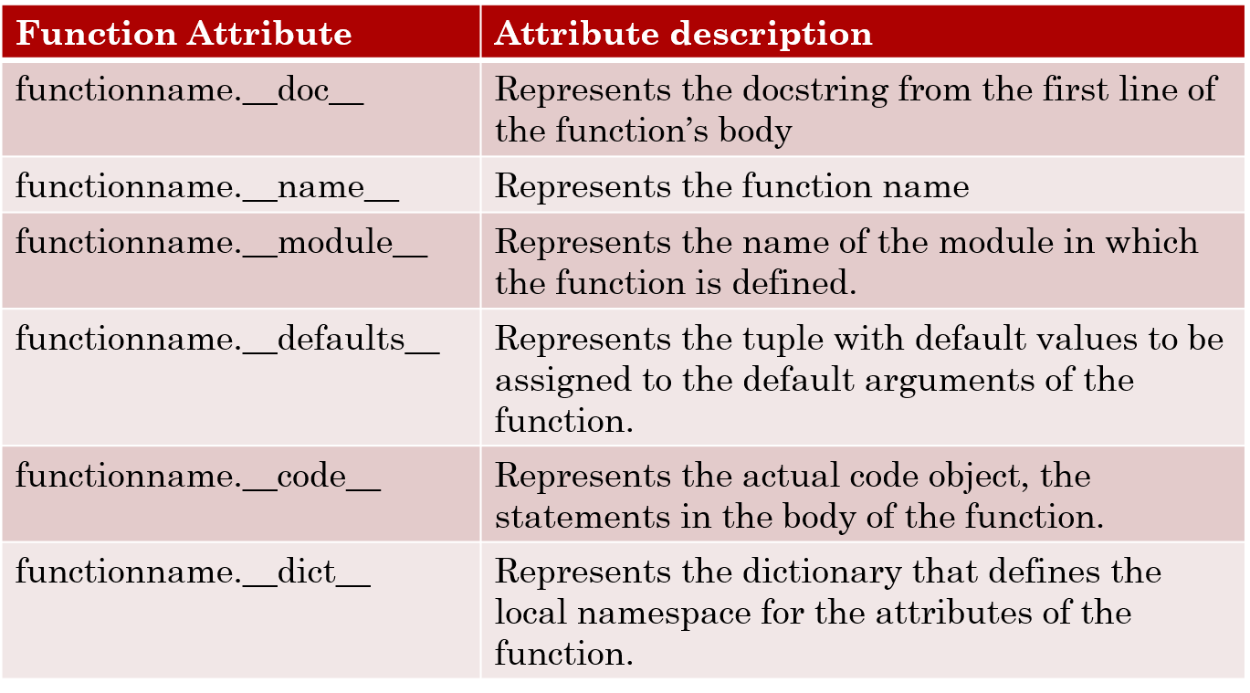
Function Attributes:
A function object has a number of attributes that you can use to get more information about the function.

Slide 20
Program:
def sum(a,b=5):
"Adds the two numbers"
return a+b
sum.version="1.0"
sum.author="abcd"
k=sum(10,20)
print('Sum is',k)
print('The documentation string is’, sum.__doc__)
print('The function name is ',sum.__name__)
print('The default values of the function are ',sum.__defaults__)
print('The code object of the function is ',sum.__code__)
print('The dictionary of the function is ',sum.__dict__)

Slide 21
Output:
Sum is 30
The documentation string is Adds the two numbers
The function name is sum
The default values of the function are (5,)
The code object of the function is <code object sum at 0x00000255C6A63770, file "D:\RINO MOL\PYTHON PPT\Python Program\Chapter 4\functions.py", line 171>
The dictionary of the function is {'version': '1.0', 'author': 'abcd'}

Slide 22
Program:
def rect(l,b):
"Computes the area of rectangle values for length and breadth are passed to the function for computation"
print("Area of rectangle is",l*b)
rect(5,8)
print(rect.__doc__)
print(rect.__name__)
print(rect.__defaults__)
print(rect.__dict__)
print(rect.__code__)
print(rect.__module__)
Output:
Area of rectangle is 40
Computes the area of rectangle values for length and breadth are passed to the function for computation
rect
None
{}
<code object rect at 0x000002AF1D42E100, file "D:\RINO MOL\PYTHON PPT\Python Program\Chapter 4\functions.py", line 185>
__main__

Slide 23
Recursion:
Recursion is defined as the process of defining something in terms of itself. It is a process in which a function calls itself.
Program:
def add(x):
if x==1:
return 1
else:
return x+add(x-1)
print("The sum of first 10 sequence number is ",add(10))
Output:
The sum of first 10 sequence number is 55

Slide 24
Iterators:
It is an object that is used to iterate over iterable objects like lists, tuples, dicts, and set.
The python iterators object is initialized using the iter() method.
It uses the next() method for iteration.
Program:
x = iter(["apple", "banana", "cherry"])
print(next(x))
print(next(x))
print(next(x))
Output:
apple
banana
cherry

Slide 25
Modules:
A module is a file consisting of a few functions and variables used for a particular task.
A module can be reused in any other program that imports it.
To import a module, use the import statement.
Program: To display calendar of the given month and year
import calendar
yy = 2024
mm = 2
print(calendar.month(yy,mm))
import calendar
yy = int(input("Enter year : "))
mm = int(input("Enter month : "))
print(calendar.month(yy,mm))
Output:
Enter year : 2024
Enter month : 2
February 2024
Mo Tu We Th Fr Sa Su
1 2 3 4
5 6 7 8 9 10 11
12 13 14 15 16 17 18
19 20 21 22 23 24 25
26 27 28 29

Slide 26
Different ways of importing a calendar module in the current program:
import calendar
calendar.prcal()
import calendar as cal #Re-name a module
cal.prcal()
from calendar import prcal
prcal()
from calendar import*
prcal()

Slide 27
Program: (import calendar using prcal() function)
import calendar
year=int(input("Enter year: "))
calendar.prcal(year)
from calendar import prcal
year=int(input("Enter year: "))
prcal(year)
from calendar import*
year=int(input("Enter year: "))
prcal(year)
import calendar as cal
year=int(input("Enter year: "))
cal.prcal(year)
Can use prcal() these ways

Slide 28
datetime module:
Program:(display the current date)
import datetime
x=datetime.datetime.now( )
print(x)
math module:
math.pi-Return the value of pi, 3.1415926535897931.
math.e-Return the value of e, 2.7182818284590451.
ceil(x)-Displays the next larger whole number.
floor(x)-Displays the next smallest whole number.

Slide 29
Program:
import math
print(math.floor(1.4))
print(math.ceil(5.0))
print(math.ceil(5.3))
print(math.ceil(-5.3))
print(math.ceil(22.6))
print(math.ceil(10.0))
Output:
1
5
6
-5
23
10
Program:
import math
r=2
x=math.pow(r,2)
p = math.pi
print(p*x)
Output:
12.566370614359172

Slide 30
Create a Module:
To create a module just save the code you want in a file.
Example:
def greeting(name):
print("Hello "+name)
greeting("John")
Use a Module:
Now we use the module we created, by using the import statement.
Example:
import mymodule
mymodule.greeting("Tom")

Slide 31
Command-Line Argument:
Command-Line arguments are used to pass arguments to a program while running it.
Each command-line arguments that you pass to the program will be stored in the sys.argv variable.
Command-Line arguments are separated by spaces.
sys.argv:
It is a list of command line arguments.
Length has ( len(sys.argv) )at least 1. Provides number of command line arguments.
sys.argv[0] is nameof current python script.

Slide 32
Program:
import sys
print(len(sys.argv))
sum=0
for i in range(1,len(sys.argv)):
sum+=int(sys.argv[i])
print("Result=",sum)
Program:
import sys
print("There are %d arguments" %len(sys.argv))
print("The command line arguments are: ")
print(sys.argv)
for i in sys.argv:
print(i)
print("Path of the Python is",sys.path)
Output:
1
Result= 0

Slide 33
The dir( ) function:
The dir( ) function is used to list the identifiers defined by a module. The identifiers are the functions, classes and variables defined in that module.
Example:
import sys,calendar
print(“Identifiers in the local scope:", dir())
print("\n Identifiers in the calendar module:", dir(calendar))
print("\n Identifiers in the sys module:", dir(sys))

Slide 34
Exercise:
Write a python program for a dice game using random module.
Write a python program to make a simple calculator using function.
Write a python program to find the area and perimeter of a circle using math module?
Write a python program to display calendar of a given month of the year?

Slide 35
Program:
import random
again = True
while again:
print(random.randint(1,6))
another_roll = input("Want to roll dice again?")
if(another_roll.lower())=="n":
continue
else:
break
Output:
6
Want to roll dice again?y
6
Want to roll dice again?y
5
Want to roll dice again?

